Slide 1
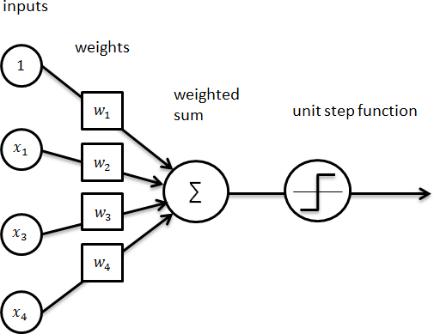
Neural Networks
Computer Vision Fall 2022, Lecture 13&14

Slide 2
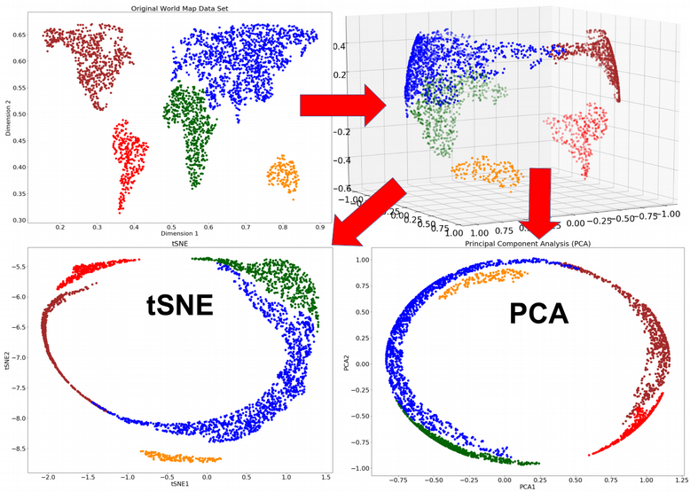

Feature Visualization
PCA is good, but it is a linear algorithm, meaning that it cannot represent complex relationship between features
t-SNE is non-linear dimensionality reduction technique that has better performance. It is designed for visualization purposes.
sklearn.decomposition.PCA
sklearn.manifold.TSNE
Example Link

Slide 3
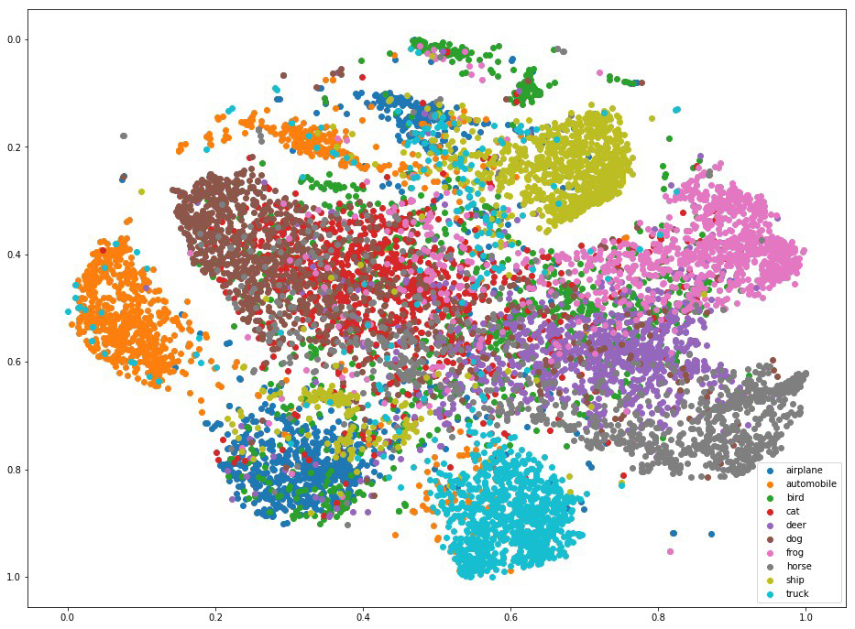
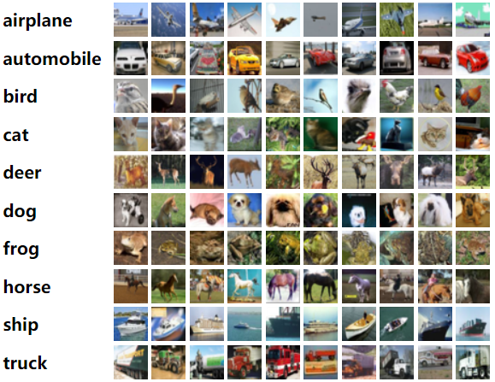
Recall CIFAR10
50,000 training images
10,000 test images
each image is 32x32x3

Slide 4

Linear Classifier – Score Function
3072x1
f(x,W) = W x
10x1 10x3072
f(x,W)
Image
10 numbers giving class scores
Array of 32x32x3 numbers (3072 numbers total)
W
parameters
or weights
Lecture 2 -

Slide 5
Linear Classifier – Score Function
f(x,W) = W x +
b
10x1
Image
10x1 10x3072
f(x,W)
10 numbers giving class scores
Array of 32x32x3 numbers (3072 numbers total)
W
parameters
or weights
Lecture 2 -

Slide 6

Example: an image with 4 pixels, and 3 classes (cat/dog/ship)
Stretch pixels into column
56
231
24
2
0.2 | -0.5 | 0.1 | 2.0
1.5 | 1.3 | 2.1 | 0.0
0 | 0.25 | 0.2 | -0.3
1.1
3.2
-1.2
-96.8
437.9
61.95
56 | 231
24 | 2
Cat score
+ =
Dog score
Ship score
Input image
W
b
Lecture 2 -

Slide 7



























Intuitively, the line that is the farthest from all interior points
What’s the best w?
Maximum Margin solution:
most stable to perturbations of data

Slide 8

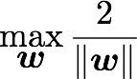

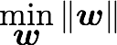
SVM can be formulated as a maximization problem
Equivalently,

Slide 9

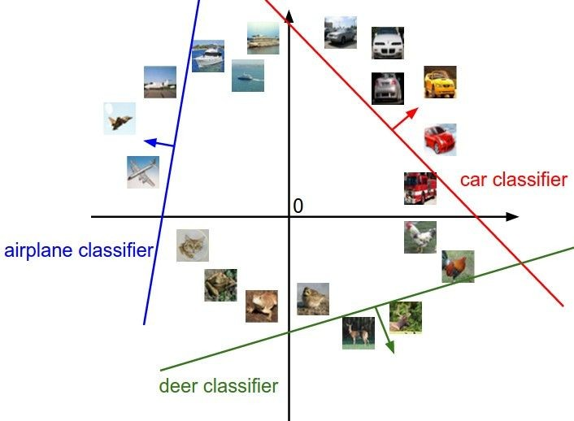
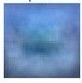
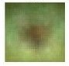
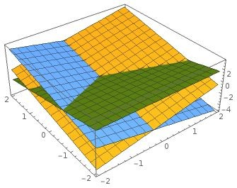
Interpreting a Linear Classifier: Geometric Viewpoint
f(x,W) = Wx + b
Array of 32x32x3 numbers (3072 numbers total)

Slide 10
Hard cases for a linear classifier
Class 1:
First and third quadrants
Class 1:
1 <= L2 norm <= 2
Class 2: Everything else
Class 1: Three modes
Class 2: Everything else
Class 2:
Second and fourth quadrants
Lecture 2 -

Slide 11

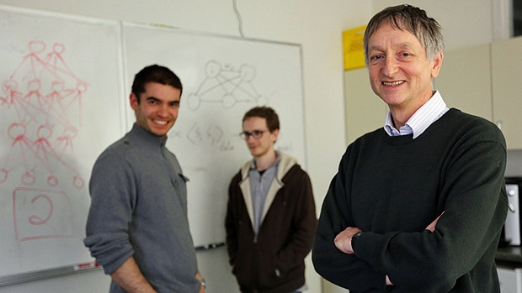


Why is everyone talking about Deep Learning?
Because a lot of money is invested in it…
DeepMind: Acquired by Google for $400 million
DNNResearch: Three-person startup (including Geoff Hinton) acquired by Google for unknown price tag
Enlitic, Ersatz, MetaMind, Nervana, Skylab: Deep Learning startups commanding millions of VC dollars
Because it made the front page of the New York Times

Slide 12
1950s Age of the Perceptron
1957 The Perceptron (Rosenblatt) 1969 Perceptrons (Minsky, Papert)
Why is everyone talking about Deep Learning?
1980s Age of the Neural Network
1986 Back propagation (Hinton)
1990s Age of the Graphical Model 2000s Age of the Support Vector Machine
2010s Age of the Deep Network
deep learning = known algorithms + computing power + big data

Slide 13
Why is everyone talking about Deep Learning?
1960s
Deep learning:
Has won numerous pattern recognition competitions
Does so with minimal feature engineering
1980s
1990s
This wasn’t always the case!
Since 1980s: Form of models hasn’t changed much, but lots of new tricks…
More hidden units
Better (online) optimization
New nonlinear functions (ReLUs)
Faster computers (CPUs and GPUs)
2006
2016
Notes:
TODO: Cut this.

Slide 14
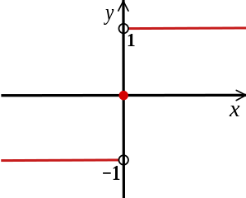
Perceptron
weights
sum
sign function
inputs
output

Slide 15
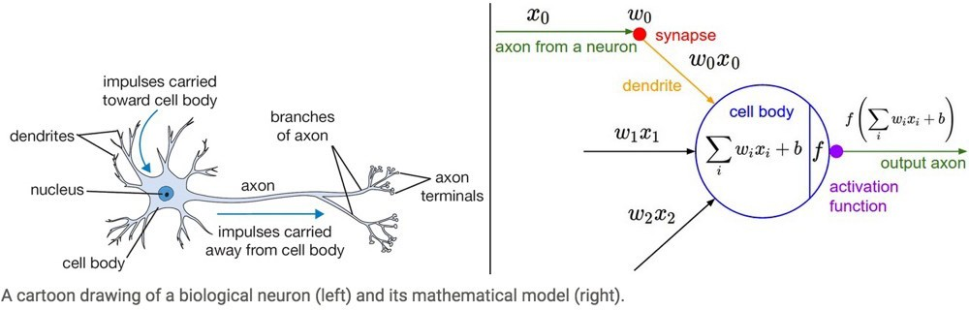
Aside: Inspiration from Biology
Neural nets/perceptrons are loosely inspired by biology.
But they certainly are not a model of how the brain works, or even how neurons work.

Slide 16
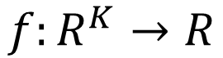
Perceptron
Neuron
$$f:R^{K}→R$$
…
Activation function
weights
bias
Notes:
sigmoid

Slide 17
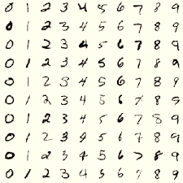
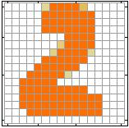
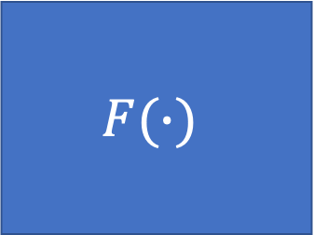
Example Application
Handwriting Digit Recognition
$$F(∙)$$
“2”
Notes:
“Hello world” for deep learning
Data: http://yann.lecun.com/exdb/mnist/

Slide 18
Handwriting Digit Recognition
Input
Output
y₁
is 1
0.1
y₂
is 2
0.7
The image is “2”
……
……
……
y₁₀
0.2
is 0
16 x 16 = 256
Ink → 1
No ink → 0
Each dimension represents the confidence of a digit.
Notes:
The same for even more complex tasks.

Slide 19
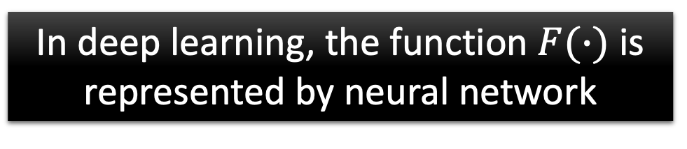
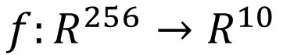
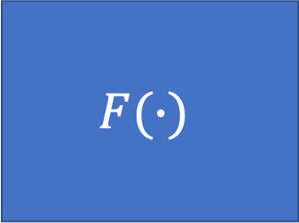
Handwriting Digit Recognition
y₁
$$F(∙)$$
y₂
“2”
……
……
y₁₀
$$f:R^{256}→R^{10}$$
In deep learning, the function $F(∙)$ is represented by neural network

Slide 20
Neural Networks

Slide 21
Connect a bunch of perceptrons together …
Neural Network
a collection of connected perceptrons

Slide 22
Connect a bunch of perceptrons together …
Neural Network
a collection of connected perceptrons
How many perceptrons in this neural network?

Slide 23
Connect a bunch of perceptrons together …
Neural Network
a collection of connected perceptrons
‘one perceptron’

Slide 24
Connect a bunch of perceptrons together …
Neural Network
a collection of connected perceptrons
‘two perceptrons’

Slide 25
Connect a bunch of perceptrons together …
Neural Network
a collection of connected perceptrons
‘three perceptrons’

Slide 26
Connect a bunch of perceptrons together …
Neural Network
a collection of connected perceptrons
‘four perceptrons’

Slide 27
Connect a bunch of perceptrons together …
Neural Network
a collection of connected perceptrons
‘five perceptrons’

Slide 28
Connect a bunch of perceptrons together …
Neural Network
a collection of connected perceptrons
‘six perceptrons’

Slide 29


Some terminology…
‘input’ layer
…also called a Multi-layer Perceptron (MLP)

Slide 30


Some terminology…
‘hidden’ layer
‘input’ layer
…also called a Multi-layer Perceptron (MLP)

Slide 31


Some terminology…
‘hidden’ layer
‘input’ layer
‘output’ layer
…also called a Multi-layer Perceptron (MLP)

Slide 32




this layer is a ‘fully connected layer’
all pairwise neurons between layers are connected

Slide 33



so is this
all pairwise neurons between layers are connected

Slide 34
How many neurons (perceptrons)?
How many weights (edges)?
How many learnable parameters total?

Slide 35
4 + 2 = 6
How many neurons (perceptrons)?
How many weights (edges)?
How many learnable parameters total?

Slide 36
How many neurons (perceptrons)?
How many weights (edges)?
4 + 2 = 6
(3 x 4) + (4 x 2) = 20
How many learnable parameters total?

Slide 37
How many neurons (perceptrons)?
How many weights (edges)?
4 + 2 = 6
(3 x 4) + (4 x 2) = 20
How many learnable parameters total?
20 + 4 + 2 = 26
bias terms

Slide 38
Neural Network
neuron
Input
Layer 1
Layer 2
Layer L
Output
……
y₁
……
y₂
……
……
……
……
……
……
y_{M}
Input Layer
Output Layer
Hidden Layers
Deep means many hidden layers
Notes:
Fully Connected Feedforward Network
You can always connect the neurons in your own way.
“+” is ignored
Each dimension corresponds to a digit (10 dimension is needed)

Slide 39
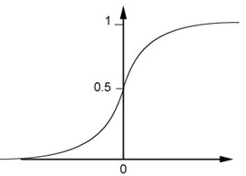
Example of Neural Network
1
4
0.98
1
-2
1
-1
-2
0.12
-1
1
0
Sigmoid Function
Notes:
Ignore +

Slide 40
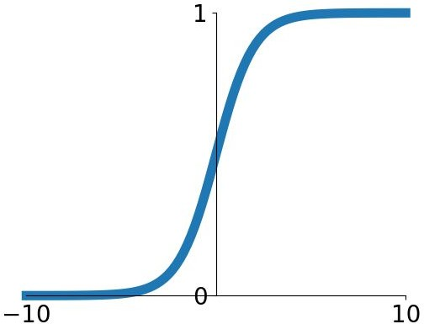
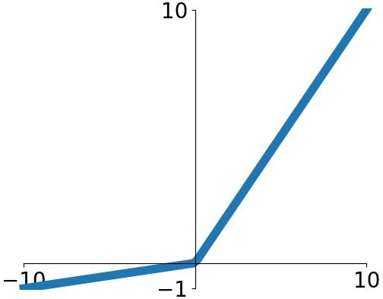
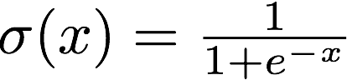
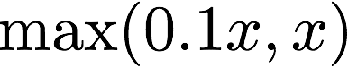
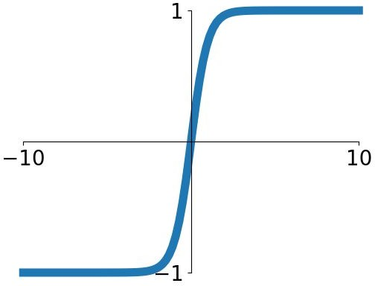
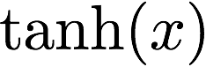
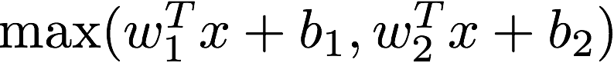
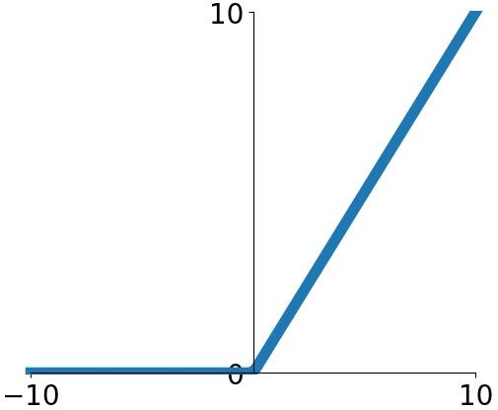
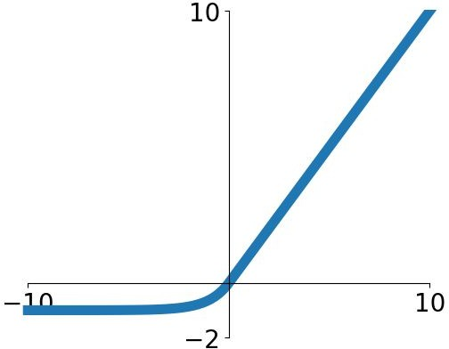
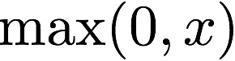
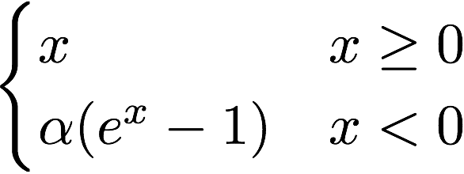
Activation functions
Sigmoid
tanh
Leaky ReLU
Maxout
ReLU
ELU
Exponential Linear Unit

Slide 41
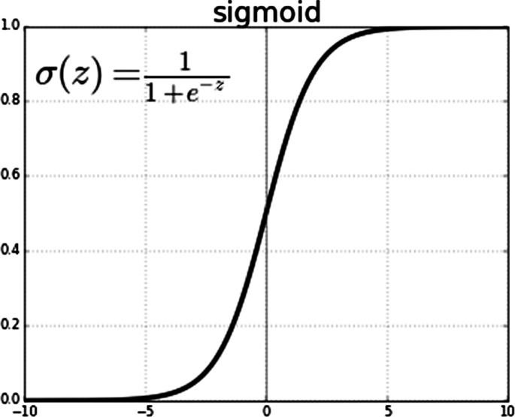
Example of Neural Network
1
4
0.98
2
0.86
3
0.62
1
-2
-1
-1
1
0
-2
-1
-2
0.12
-2
0.11
-1
0.83
-1
1
-1
4
0
0
2

Slide 42
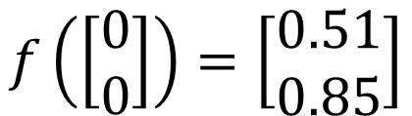
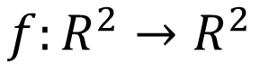
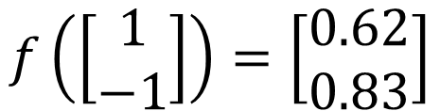
Example of Neural Network
1
0.73
2
0.72
3
0.51
0
-2
-1
-1
1
0
-2
-1
0.5
-2
0.12
-1
0.85
0
1
-1
4
0
0
2
$$f:R^{2}→R^{2}$$
$$f\left(\left[\begin{matrix}1 \\ −1\end{matrix}\right]\right)=\left[\begin{matrix}0.62 \\ 0.83\end{matrix}\right]$$
$$f\left(\left[\begin{matrix}0 \\ 0\end{matrix}\right]\right)=\left[\begin{matrix}0.51 \\ 0.85\end{matrix}\right]$$
Different parameters define different function
Notes:
For example, if we modify “1” to “2”, then we have another function

Slide 43
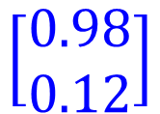

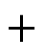
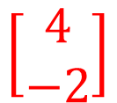
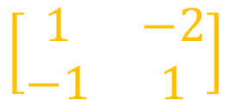
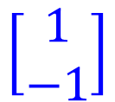

Matrix Operation
1
4
0.98
1
-2
1
0.12
-1
-2
-1
1
0
$$\left[\begin{matrix}1 & −2 \\ −1 & 1\end{matrix}\right]$$
$$\left[\begin{matrix}1 \\ −1\end{matrix}\right]$$
$$\left[\begin{matrix}1 \\ 0\end{matrix}\right]$$
$$=$$
$$\left[\begin{matrix}0.98 \\ 0.12\end{matrix}\right]$$
$$σ\left( \right)$$
$$+$$
$$\left[\begin{matrix}4 \\ −2\end{matrix}\right]$$
Notes:
Make sure you know how to do it
author: Adam Coates, Baidu, Inc.
Deep Learning (hopefully faster)
http://videolectures.net/deeplearning2015_coates_deep_learning/

Slide 44
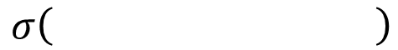
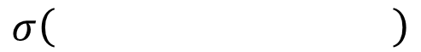
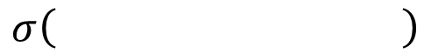
Neural Network
……
y₁
W¹
W²
W^{L}
……
y₂
b¹
b²
b^{L}
……
……
……
……
……
x
a¹
a²
y
……
y_{M}
W¹
x
b¹
+
$$σ\left( \right)$$
a¹
b²
W²
+
$$σ\left( \right)$$
W^{L}
b^{L}
a^{L-1}
+
$$σ\left( \right)$$
Notes:
Draw it?

Slide 45
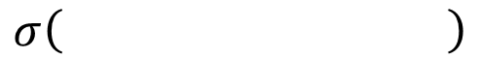
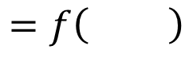
Neural Network
……
y₁
W¹
W²
W^{L}
……
y₂
b¹
b²
b^{L}
……
……
……
……
……
x
a¹
a²
y
……
y_{M}
y
x
Using parallel computing techniques to speed up matrix operation
$$=f\left( \right)$$
W^{L}
…
W²
W¹
x
b¹
b²
…
b^{L}
+
+
+
$$σ\left( \right)$$
$$=σ\left( \right)$$
$$σ\left( \right)$$
x
Notes:
Draw it?

Slide 46
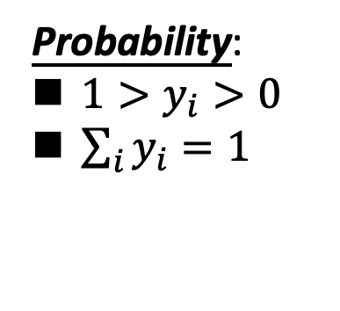
Softmax [Classification]
Probability:
$1>y_{i}>0$
$\sum_{i}{y_{i}=1}$
Softmax layer as the output layer
Ordinary Layer
In general, the output of network can be any value.
May not be easy to interpret
Notes:
Original output layer is local

Slide 47
Softmax [Classification]
Probability:
$1>y_{i}>0$
$\sum_{i}{y_{i}=1}$
Softmax layer as the output layer
Softmax Layer
3
20
0.88
1
2.7
0.12
-3
0.05
≈0
Notes:
Why it is name soft max?
Monotonicity of softmax
Non-locality of softmax

Slide 48


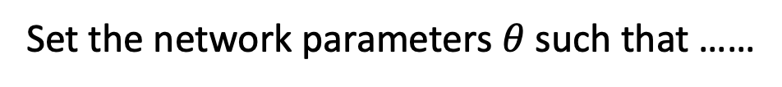
How to set network parameters
$$θ=\left\{W^{1},b^{1},W^{2},b^{2},⋯W^{L},b^{L}\right\}$$
……
y₁
is 1
0.1
……
y₂
0.7
is 2
Softmax
……
……
……
……
y₁₀
is 0
0.2
16 x 16 = 256
Ink → 1
No ink → 0
Set the network parameters $θ$ such that ……
Input:
How to let the neural network achieve this
y₁ has the maximum value
Input:
y₂ has the maximum value

Slide 49


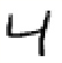





Training Data
Preparing training data: images and their labels
“5”
“0”
“4”
“1”
“9”
“2”
“1”
“3”
Using the training data to find the network parameters.

Slide 50
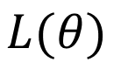

Cost
Given a set of network parameters $θ$, each example has a cost value.
“1”
……
y₁
0.2
1
……
y₂
0
0.3
……
……
……
Cost
……
……
……
y₁₀
$$L(θ)$$
0
0.5
target
Cost can be Euclidean distance or cross entropy of the network output and target
Notes:
With softmax, the summation of all the ouputs would be one.
Can be considered as probability if you want ……

Slide 51










Total Cost
For all training data …
Total Cost:
NN
$$C\left(θ\right)=\sum_{r=1}^{R}{L^{r}\left(θ\right)}$$
x¹
y¹
$${\hat{y}}^{1}$$
$$L^{1}\left(θ\right)$$
x²
NN
y²
$${\hat{y}}^{2}$$
$$L^{2}\left(θ\right)$$
x³
NN
y³
$${\hat{y}}^{3}$$
$$L^{3}\left(θ\right)$$
……
……
……
……
Find the network parameters $θ^{∗}$ that minimize this value
x^{R}
NN
y^{R}
$${\hat{y}}^{R}$$
$$L^{R}\left(θ\right)$$
Notes:
Randomly picked one
Two approaches update the parameters towards the same direction, but stochastic is faster!
Better!

Slide 52
Training Neural Networks

Slide 53
Let's start easy

Slide 54
World's smallest perceptron!
(a.k.a. line equation, linear regression)

Slide 55




Learning a Perceptron
Given a set of samples and a Perceptron
what is this activation function?
linear function!
Estimate the parameters of the Perceptron

Slide 56
Given training data:
10 10.1
2
1.9
3.5 3.4
1
1.1
What do you think the weight parameter is?
not so obvious as the network gets more complicated so we use …

Slide 57












An Incremental Learning Strategy
(gradient descent)
Given several examples
and a perceptron
what does this mean?
Modify weight
such that
gets ‘closer’ to
perceptron parameter
perceptron output
true label

Slide 58
Loss Function
Defines what it means to be close to the true solution
Before diving into gradient descent, we need to understand …
YOU get to choose the loss function!
(some are better than others depending on what you want to do)

Slide 59



Squared Error (L2)
(a popular loss function) ((why?))

Slide 60






L2 Loss
L1 Loss
Zero-One Loss
Hinge Loss

Slide 61
Back to the…
World’s Smallest Perceptron!
(a.k.a. line equation, linear regression)
function of ONE parameter!

Slide 62


Learning Strategy (gradient descent)
Given several examples
and a perceptron
Modify weight
such that
gets ‘closer’ to
perceptron parameter
perceptron output
true label

Slide 63


Code to train your perceptron:
$$x_{n}$$
just one line of code!
Now where does this come from?

Slide 64
Gradient descent

Slide 65
(partial) derivatives tell us how much one variable affects another

Slide 66


Two ways to think about them:
Slope of a function
Knobs on a machine

Slide 67






1. Slope of a function:
Describes the slope around a point

Slide 68










2. Knobs on a machine:
input
output
describes how each ‘knob’ affects the
output
small change in parameter
output will change by

Slide 69







Gradient descent:
Given a fixed-point on a function, move in the direction opposite of the gradient

Slide 70









Gradient descent:
update rule:

Slide 71





Local Minima
Gradient descent never guarantee global minima
Different initial point $θ^{0}$
$$C$$
Reach different minima, so different results
Who is Afraid of Non-Convex Loss Functions?
http://videolectures.net/eml07_lecun_wia/
$$w_{1}$$
$$w_{2}$$

Slide 72



Besides local minima ……
cost
Very slow at the plateau
Stuck at saddle point
Stuck at local minima
$$∇C\left(θ\right)≈0$$
$$∇C\left(θ\right)=0$$
$$∇C\left(θ\right)=0$$
parameter space

Slide 73
Backpropagation

Slide 74



Backpropagation
A network can have millions of parameters.
Backpropagation is the way to compute the gradients efficiently
Ref: http://speech.ee.ntu.edu.tw/~tlkagk/courses/MLDS_2015_2/Lecture/DNN%20backprop.ecm.mp4/index.html
Many toolkits can compute the gradients automatically
Ref: http://speech.ee.ntu.edu.tw/~tlkagk/courses/MLDS_2015_2/Lecture/Theano%20DNN.ecm.mp4/index.html
Notes:
Just a function

Slide 75
Training: Backprop algorithm
The Backprop algorithm searches for weight values that minimize the total error of the network over the set of training examples (training set).
Backprop consists of the repeated application of the following two passes:
Forward pass: in this step the network is activated on one example and the error of (each neuron of) the output layer is computed.
Backward pass: in this step the network error is used for updating the weights. Starting at the output layer, the error is propagated backwards through the network, layer by layer. This is done by recursively computing the local gradient of each neuron.

Slide 76
Back Propagation
Back-propagation training algorithm
Backprop adjusts the weights of the NN in order to minimize the network total mean squared error.
Network activation
Forward Step
Error propagation
Backward Step

Slide 77
Back to the…
World’s Smallest Perceptron!
(a.k.a. line equation, linear regression)
function of ONE parameter!

Slide 78


Training the world’s smallest perceptron
This is just gradient descent, that means…
$$x_{n}$$
this should be the gradient of the loss function

Slide 79







…is the rate at which this will change…
the loss function
… per unit change of this
the weight parameter
Let’s compute the derivative…

Slide 80


Compute the derivative
just shorthand
That means the weight update for gradient descent is:
move in direction of negative gradient

Slide 81



Gradient Descent (world’s smallest perceptron)
For each sample
Predict
Forward pass
Compute Loss
Update
Back Propagation
Gradient update

Slide 82
world’s (second) smallest
perceptron!
function of two parameters!

Slide 83



Gradient Descent
For each sample
Predict
Forward pass
Compute Loss
we just need to compute partial derivatives for this network
Update
Back Propagation
Gradient update

Slide 84




Derivative computation
Why do we have partial derivatives now?

Slide 85




Derivative computation
Gradient Update

Slide 86







Gradient Descent
For each sample
Predict
Forward pass
Compute Loss
(side computation to track loss. not needed for backprop)
two lines now
Update
Back Propagation
Gradient update
(adjustable step size)

Slide 87
We haven’t seen a lot of ‘propagation’ yet because our perceptrons only had one layer…

Slide 88

multi-layer perceptron
function of FOUR parameters and FOUR layers!

Slide 89

input
weight
Sum activation
weight
Sum activation
weight
Sum activation
input layer 1
hidden layer 2
hidden layer 3
output layer 4

Slide 90


input
weight
Sum activation
weight
Sum activation
weight
Sum activation
input layer 1
hidden layer 2
hidden layer 3
output layer 4

Slide 91

input
weight
sum activation
weight
activation
weight
activation
input layer 1
hidden layer 2
hidden layer 3
output layer 4

Slide 92

input
weight
sum activation
weight
activation
weight
activation
input layer 1
hidden layer 2
hidden layer 3
output layer 4

Slide 93


input
weight
sum activation
weight
activation
weight
activation
input layer 1
hidden layer 2
hidden layer 3
output layer 4

Slide 94
Entire network can be written out as one long equation
We need to train the network:
What is known? What is unknown?

Slide 95


Entire network can be written out as a long equation
known
We need to train the network:
What is known? What is unknown?

Slide 96







Entire network can be written out as a long equation
activation function sometimes has parameters
unknown
We need to train the network:
What is known? What is unknown?

Slide 97


Learning an MLP
Given a set of samples and an MLP
Estimate the parameters of the MLP

Slide 98




Gradient Descent
For each random sample
Predict
Forward pass
Compute Loss
Update
Back Propagation
Gradient update
vector of parameter partial derivatives
vector of parameter update equations

Slide 99

So we need to compute the partial derivatives

Slide 100


Remember, Partial derivative
describes…
affect…
this
…this
does
how
(loss layer)
So, how do you compute it?

Slide 101

The Chain Rule

Slide 102










According to the chain rule…
Intuitively, the effect of weight on loss function :
rest of the network
depends on
depends on
depends on

Slide 103

Chain Rule!
rest of the network

Slide 104


Just the partial derivative of L2 loss
rest of the network

Slide 105


rest of the network
Let’s use a Sigmoid function

Slide 106

rest of the network
Let’s use a Sigmoid function

Slide 107

rest of the network

Slide 108




Slide 109


already computed. re-use (propagate)!

Slide 110
The Chain Rule
a.k.a. backpropagation

Slide 111



The chain rule says…
depends on
depends on
depends on
depends on
depends on
depends on
depends on

Slide 112


The chain rule says…
depends on
depends on
depends on
depends on
depends on
depends on
depends on
already computed. re-use (propagate)!

Slide 113



depends on
depends on
depends on
depends on
depends on
depends on
depends on

Slide 114


depends on
depends on
depends on
depends on
depends on
depends on
depends on

Slide 115


depends on
depends on
depends on
depends on
depends on
depends on
depends on

Slide 116


Gradient Descent
For each example sample
Predict
Forward pass
Compute Loss
Update
Back Propagation
Gradient update

Slide 117

Gradient Descent
For each example sample
Predict
Forward pass
Compute Loss
Update
Back Propagation
Gradient update
vector of parameter partial derivatives
vector of parameter update equations

Slide 118
Stochastic gradient descent

Slide 119

What we are truly minimizing:
The gradient is:

Slide 120

What we are truly minimizing:
The gradient is:
What we use for gradient update is:

Slide 121

What we are truly minimizing:
The gradient is:
What we use for gradient update is:

Slide 122
Stochastic Gradient Descent
For each example sample
Predict
Forward pass
Compute Loss
Update
Back Propagation
Gradient update
vector of parameter partial derivatives
vector of parameter update equations

Slide 123
How do we select which sample?

Slide 124
How do we select which sample?
Select randomly!
Do we need to use only one sample?

Slide 125













Mini-batch
Randomly initialize $θ^{0}$
x¹
NN
y¹
Pick the 1st batch
$${\hat{y}}^{1}$$
$$C^{1}$$
$$C=C^{1}+C^{31}+⋯$$
Mini-batch
NN
x³¹
y³¹
$${\hat{y}}^{31}$$
$$θ^{1}←θ^{0}−η∇C\left(θ^{0}\right)$$
$$C^{31}$$
Pick the 2nd batch
……
$$C=C^{2}+C^{16}+⋯$$
NN
$$θ^{2}←θ^{1}−η∇C\left(θ^{1}\right)$$
x²
y²
$${\hat{y}}^{2}$$
$$C^{2}$$
…
Until all mini-batches have been picked
Mini-batch
x¹⁶
NN
y¹⁶
$${\hat{y}}^{16}$$
$$C^{16}$$
one epoch
……
Repeat the above process
Notes:
Ｉｎ ｏｐｅｎ ｅｐｏｃｈ， ｕｐｄａｔｅ ｍａｎｙ ｔｉｍｅｓ
Shuffle data, and repeat above process

Slide 126
How do we select which sample?
Select randomly!
Do we need to use only one sample?
You can use a minibatch of size B < N.
Why not do gradient descent with all samples?

Slide 127
How do we select which sample?
Select randomly!
Do we need to use only one sample?
You can use a minibatch of size B < N.
Why not do gradient descent with all samples?
It’s very expensive when N is large (big data).
Do I lose anything by using stochastic GD?

Slide 128
How do we select which sample?
Select randomly!
Do we need to use only one sample?
You can use a minibatch of size B < N.
Why not do gradient descent with all samples?
It’s very expensive when N is large (big data).
Do I lose anything by using stochastic GD?
Same convergence guarantees and complexity!
Better generalization.

Slide 129
Why Deep?

Slide 130

Universality Theorem
Any continuous function f
Can be realized by a network with one hidden layer
(given enough hidden neurons)
Reference for the reason: http://neuralnetworksanddeeplearning.com/chap4.html
Why “Deep” neural network not “Fat” neural network?

Slide 131
Fat + Short v.s. Thin + Tall
The same number of parameters
Which one is better?
……
……
……
Shallow
Deep

Slide 132

Recipe for Learning
http://www.gizmodo.com.au/2015/04/the-basic-recipe-for-machine-learning-explained-in-a-single-powerpoint-slide/
Notes:
今年四月的 GTC

Slide 133
Recipe for Learning
Don’t forget!
overfitting
Modify the Network
Preventing
Overfitting
Better optimization Strategy
http://www.gizmodo.com.au/2015/04/the-basic-recipe-for-machine-learning-explained-in-a-single-powerpoint-slide/
Notes:
Last one is on training set
Sometimes students ask

Slide 134
Deeper Networks
Decision Functions
Output
y
Hidden Layer 3
c₁
c₂
…
c_{F}
Hidden Layer 2
b₁
b₂
…
b_{E}
Hidden Layer 1
a₁
a₂
…
a_{D}
Input
x₁
x₂
x₃
…
x_{M}

Slide 135
Different Levels of Abstraction
Decision Functions
We don’t know the “right” levels of abstraction
So let the model figure it out!
Example from Honglak Lee (NIPS 2010)
Notes:
TODO: Make pixels greyscle
TODO: Increase size of 1st hidden layer

Slide 136
Different Levels of Abstraction
Decision Functions
Face Recognition:
Deep Network can build up increasingly higher levels of abstraction
Lines, parts, regions
Example from Honglak Lee (NIPS 2010)
Notes:
TODO: Make pixels greyscle
TODO: Increase size of 1st hidden layer

Slide 137
Different Levels of Abstraction
Decision Functions
Output
y
Hidden Layer 3
c₁
c₂
…
c_{F}
Hidden Layer 2
b₁
b₂
…
b_{E}
Hidden Layer 1
a₁
a₂
…
a_{D}
Input
x₁
x₂
x₃
…
x_{M}
Example from Honglak Lee (NIPS 2010)

